Slide 1
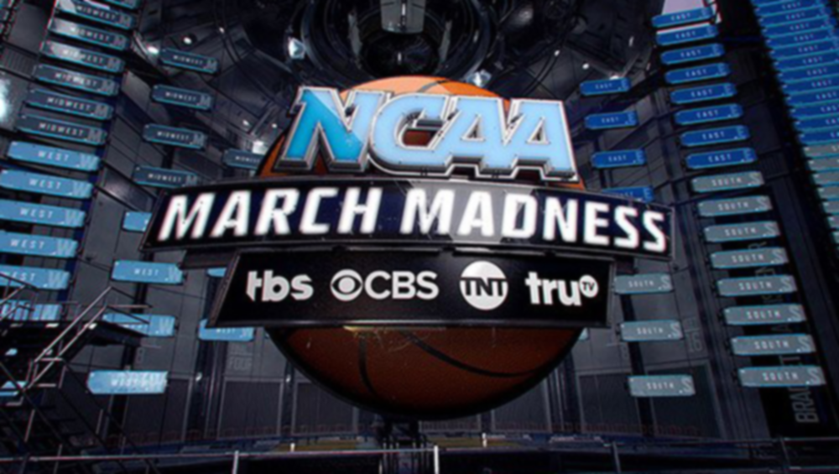
Crafting the Perfect March Madness Bracket
By: Joe Coyne

Slide 2
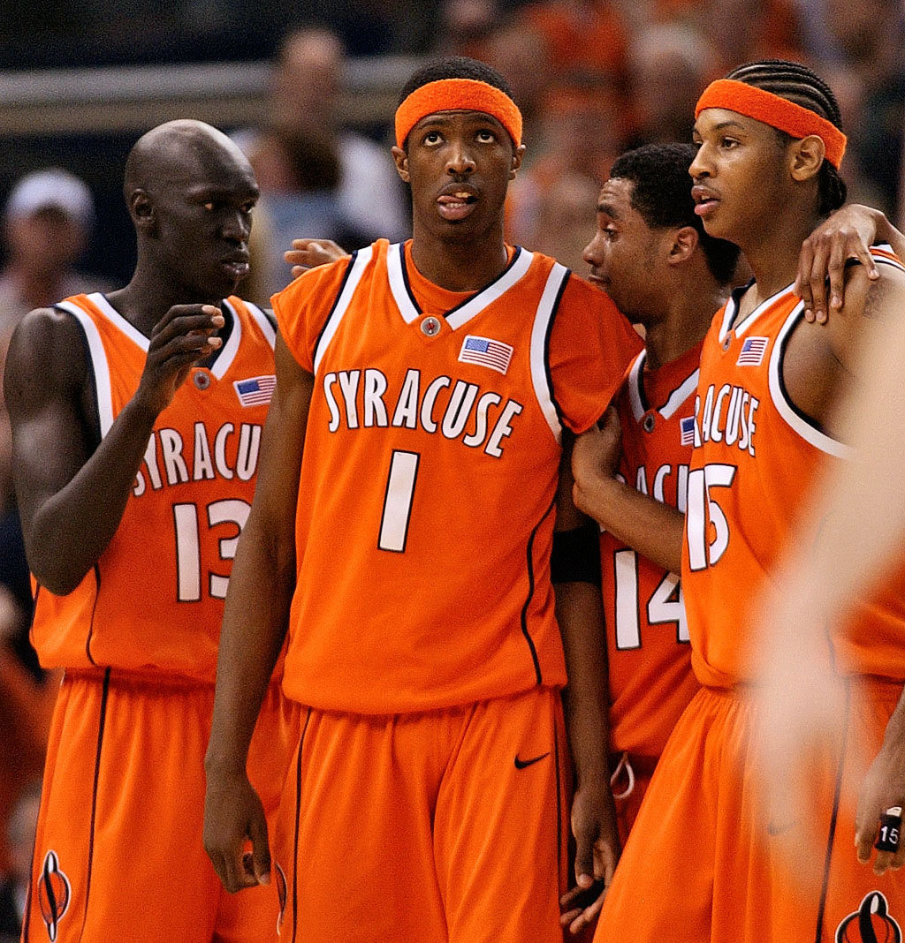
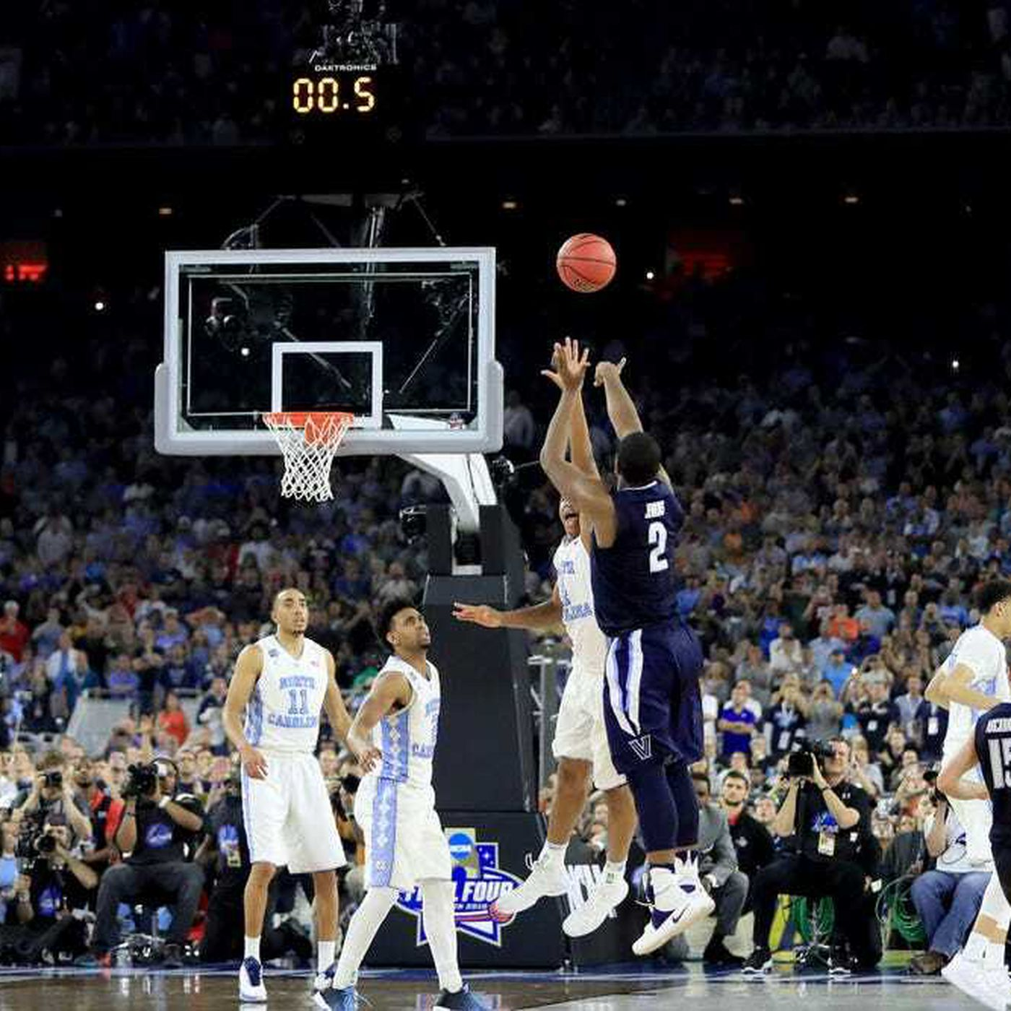
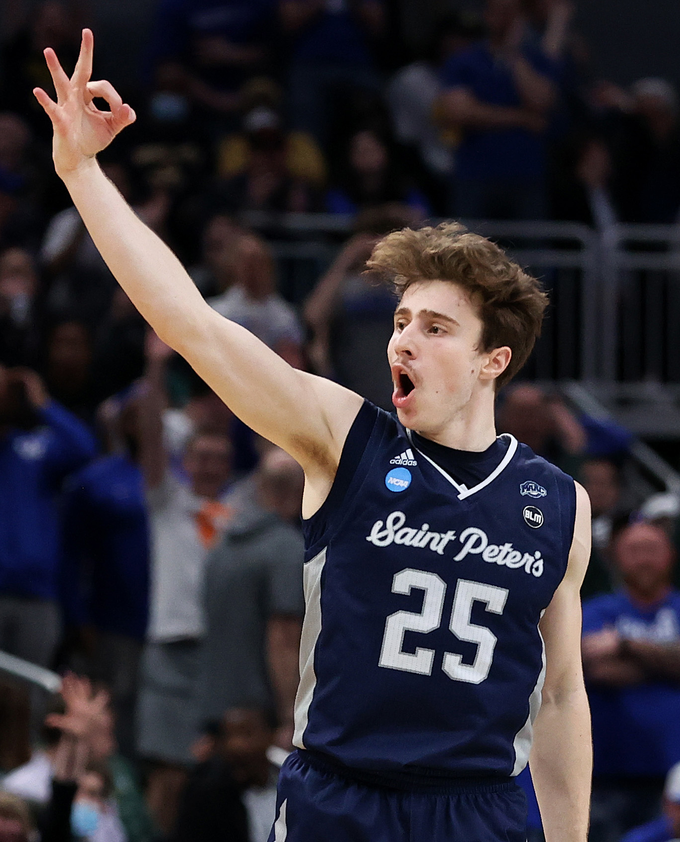
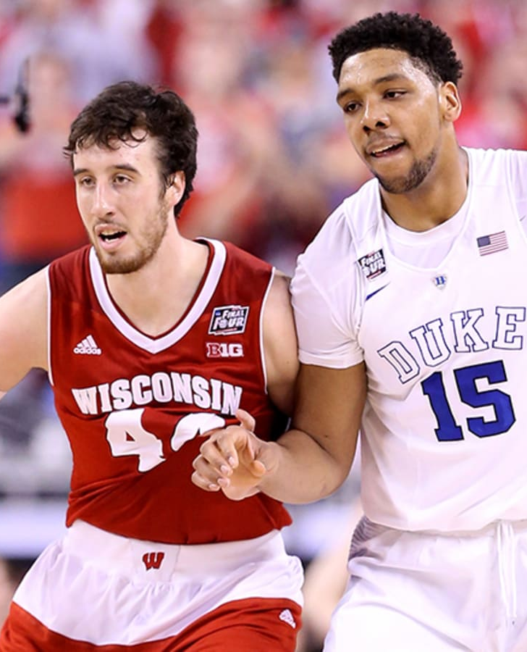
Goal/Hypothesis
An analysis of regular season college basketball data to predict NCAA Tournament outcomes and winners
How does regular season performance translate into postseason play?
How well can we model the overall trends of the NCAA Tournament and have the most accurate bracket?
Notes:
The goals for my project remained relatively the same throughout the semester. The one slight shift is that I focused less on the individual matchups in the tournament, but rather the overall trends of the tournament. For instance, what teams advance further in the tournament and ultimately win, and what differentiates these teams?

Slide 3
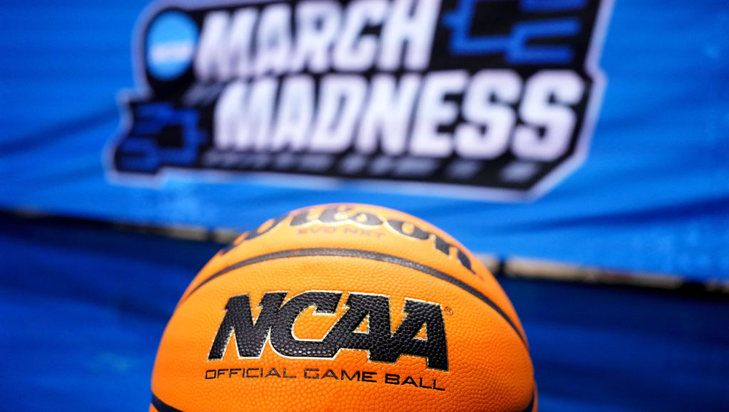
Research Questions
Central research question: How can we best predict the outcomes and top teams of an NCAA Tournament?
Are offensively-minded teams better suited for the tournament over defensively-minded teams?
Does conference matter? How strong of predictors are SOS (Strength of Schedule) and SRS (Simple Rating System)?
How important are the newer and more advanced statistics to predicting postseason wins?
If the 2019-2020 season were to have run uninterrupted, how would the tournament unfold and who would end up as the champion?
Notes:
Research questions remained pretty much the same as well
- Focused mostly on overall trends and general predictability

Slide 4
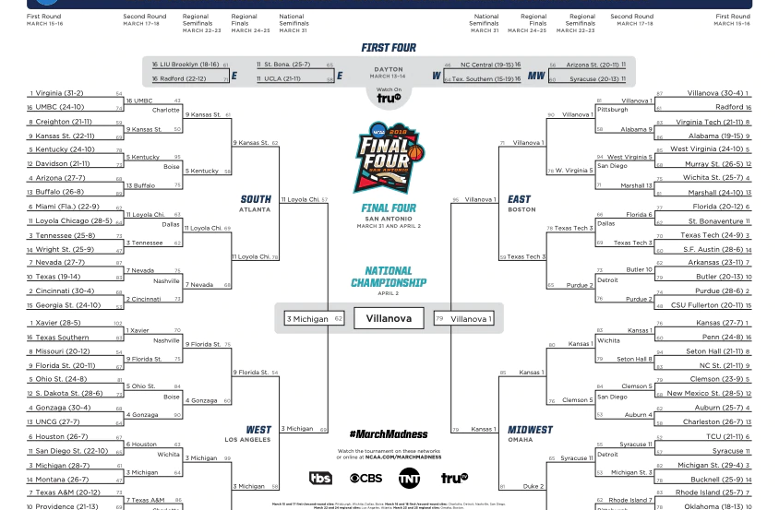
Data
All data is from 2002-2003 season through the 2019-2020 season
Kaggle (from competition: “March Machine Learning Mania 2021 - NCAAM – Spread”)
Basic statistics
Tracked on a game by game basis
Sports Reference (https://www.sports-reference.com/cbb/)
More advanced metrics
Season statistics for each team
Notes:
Only change from my last presentation is that I added in Sports Reference data

Slide 5
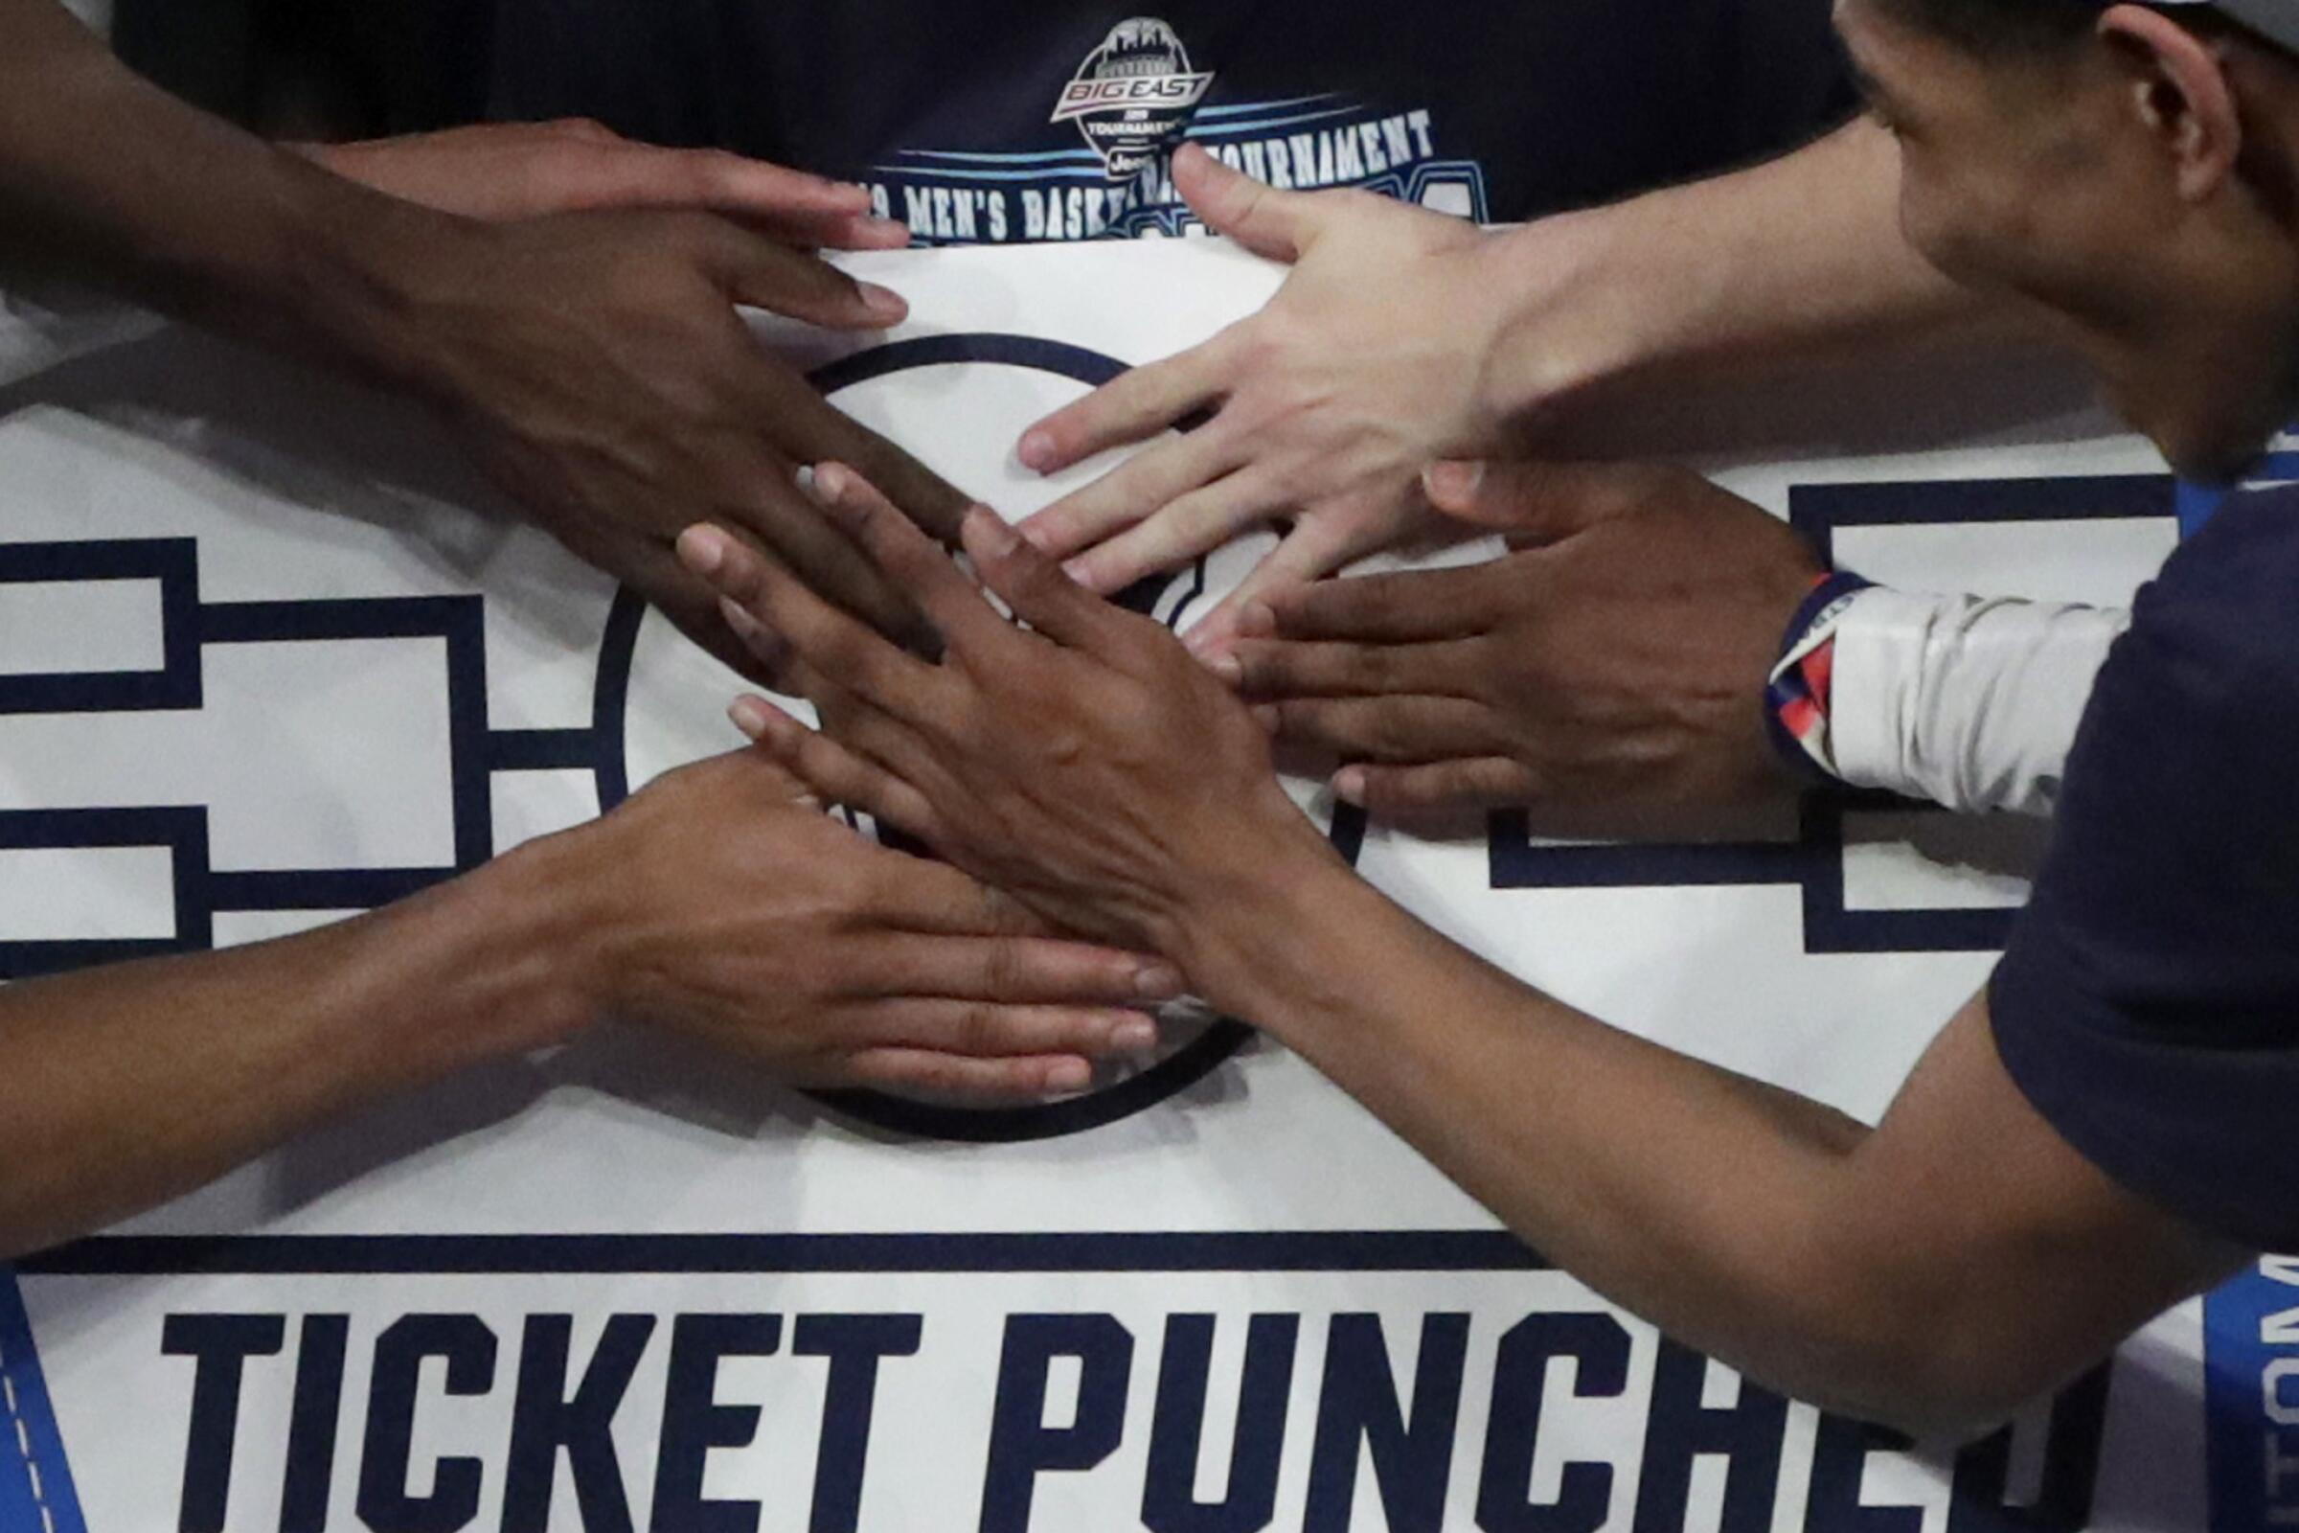
Variables
Kaggle
New variables
Basic season stats summarized by year
Created “PostW” variable to quantify NCAA Tournament wins
Sports reference
More advanced statistics and metrics
FTr
3PAr
TRB%
AST%
BLK%
Notes:
To create the models, I only took teams that made that year’s tournament to reduce the class imbalance (there are a lot more teams each year that win 0 postseason games (about 300 teams) vs teams that win at least 1)
Advanced stats that I used:
- FTr – Free Throw Rate (Number of FT Attempts per FG Attempt)
- 3PAr – 3-Point Attempt Rate (% of FG attempts from 3-point range)
- TRB% - Total Rebound Percentage (estimate of % of available rebounds a player grabbed while on the floor)
- AST% - Assist Percentage (estimate of % of teammate field goals a player assisted while on the floor)
- BLK % - Block Percentage (estimate of % of opponent two-point field goal attempts blocked by the player while on the floor)

Slide 6
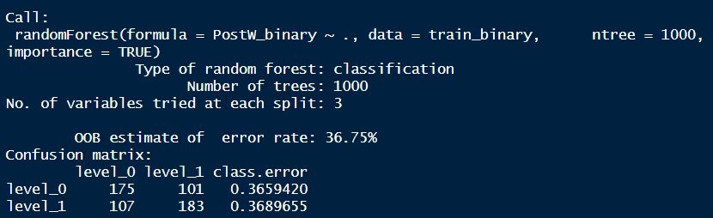
Initial Binary Model
Random Forest Model:
An aggregate model based on the average of n decision tree models
Each random forest model takes a subset of variables to predict and filters through which ones enter and leave the model
Accuracy = 0.6590106
OOB Estimate of Error = 36.75%
Notes:
In order to further address the class imbalance issue, an initial binary model was created (by creating a new variable called PostW_binary, where if the team lost in the first round, it would be denoted with a 0, and all others that won in the first round got a 1)
- The Random Forest Model had the highest accuracy of all the binary models, with an accuracy of 0.6590106
(aggregate model based on the average of n decision tree models; each random forest model takes a subset of variables to predict and filters through which ones enter and leave the model)
- Out of Bag Estimate of 36.75% -> acts as a test or validation data set; this represents the variables that were left out of the specific iteration of the model
- The other binary models I ran (jackknife, stepwise selection) can be found in my paper

Slide 7
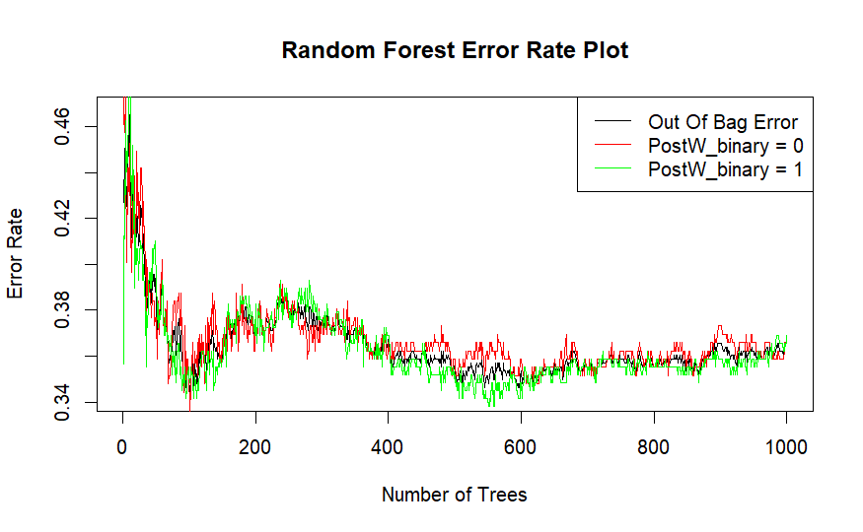
Initial Binary Model
Notes:
X-axis -> number of decision trees built in the random forest model (graph shows how the misclassification / error rate changes depending on the number of decision trees built into the model
Once again, Out of Bag Error is the baseline / validation error

Slide 8
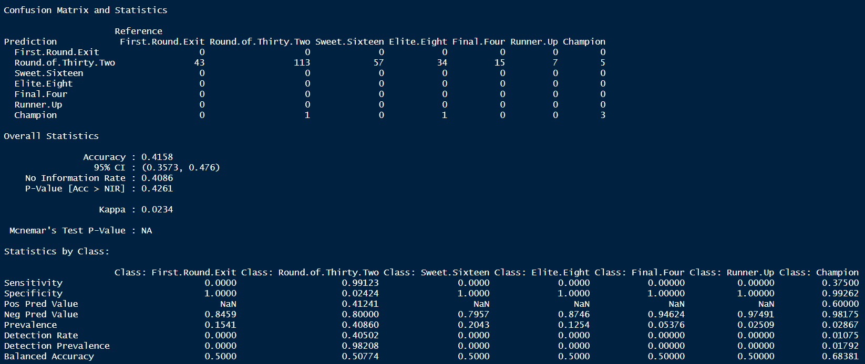
Full Models
Jackknife and Leave One Out Cross Validation
Notes:
Applied the binary predictions to the full dataset and filters only teams that were predicted to have at least 1 win
Before creating the full models, some variables were removed for multicollinearity, such as Losses, total_pts, total_FGA, TOV_percent
Similar to K fold cross validation, the jackknife and leave one out cross validation resample by systematically leaving one observation out of the dataset at a time and then calculating the estimate of interest for each subset. So in a dataset with N observations, you would create N subsets, each containing N-1 observations.
Area Under ROC Curve = 0.6318
We use area under the curve instead of accuracy as our performance metric for all the full models, because even though we partially dealt with the class imbalance issue, when all the seasons are pooled together, there is still an overwhelming number of observations in the Round of 32 value. The model is bound to predict some of these wrong, but since it’s at a larger scale, these incorrect predictions will skew the accuracy, whereas it won’t skew the area under the ROC curve

Slide 9
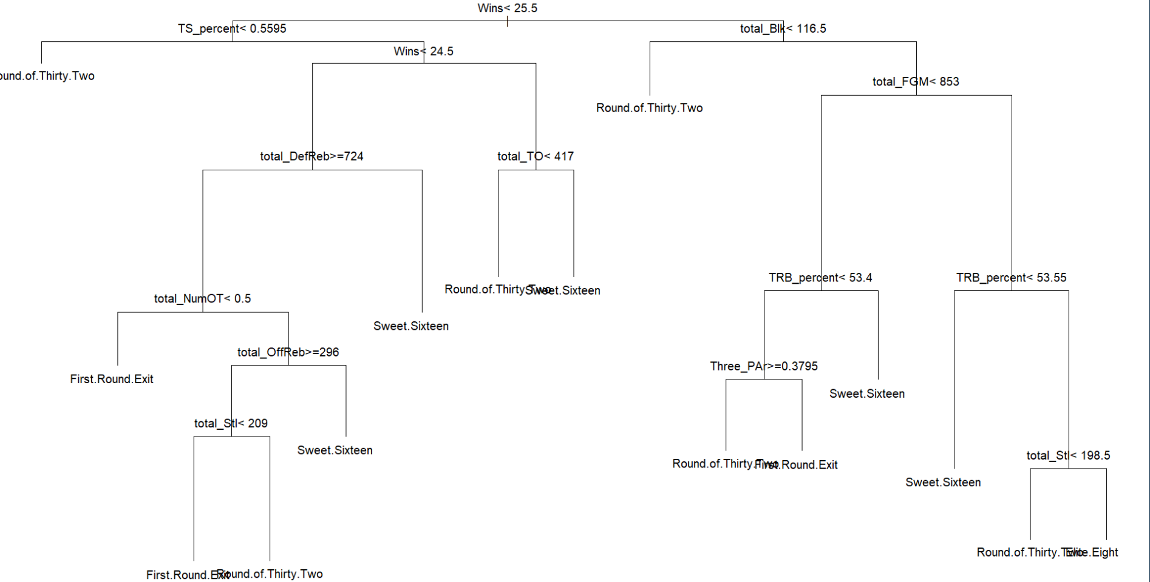
Full Models
Decision Tree
Notes:
Interpretation: If you are predicted to have at least 1 postseason win and have more than 25.5 wins, but have less than 116.5 blocks, you will be eliminated in the Round of 32

Slide 10
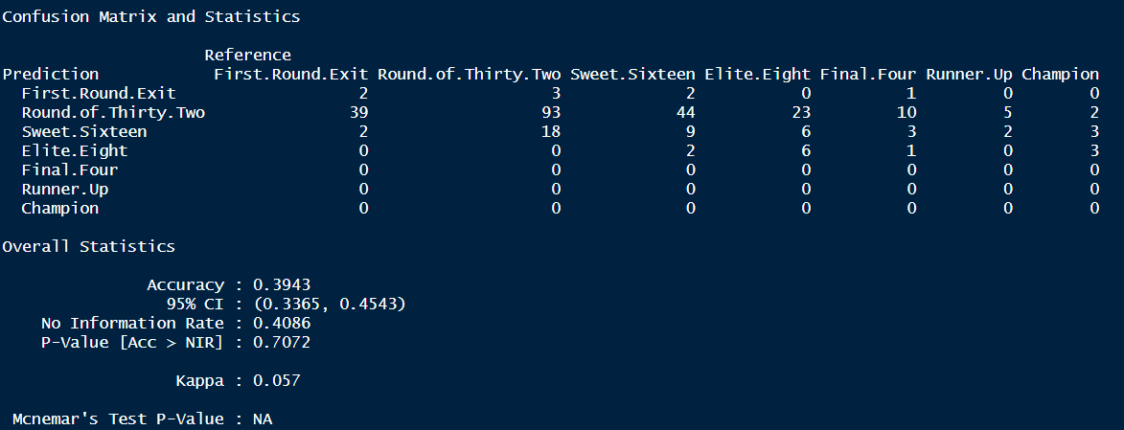
Full Models
Decision Tree
Notes:
Area under the ROC curve = 0.625, which is slightly worse than the jackknife model

Slide 11
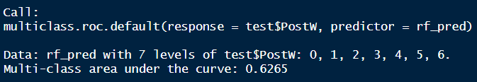
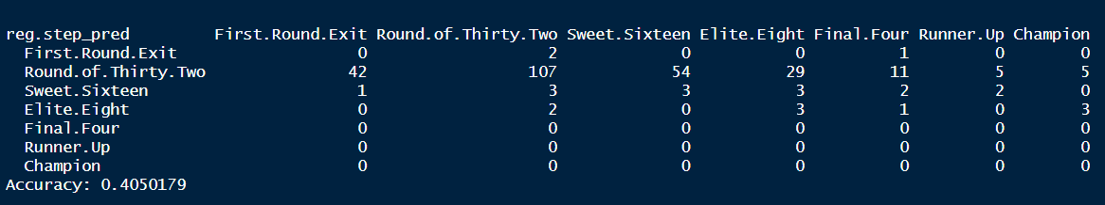
Full Models
Stepwise Selection
Notes:
Had to use polr( ) function since target variable PostW is an ordinal variable
- polr = Ordered Logistic or Probit Regression, which fits a logistic or probit regression model to an ordered factor response
- Area under the ROC curve = 0.6265, which is slightly worse than the jackknife model as well

Slide 12
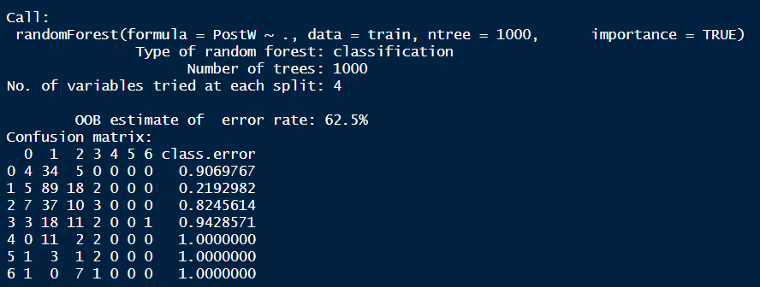
Full Models
Random Forest
Notes:
OOB Error = Out of Bag Error

Slide 13
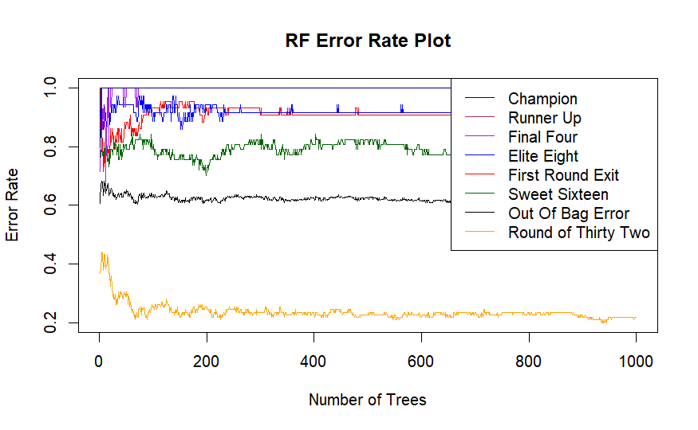
Full Models
Random Forest
Notes:
As you can see, Round of 32 has the lowest misclassification rate. This is most likely because there are so many more observations of this value of PostW than any others

Slide 14
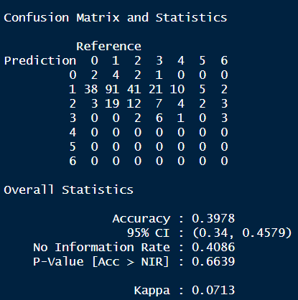
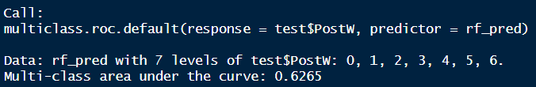
Full Models
Random Forest
Notes:
Confusion matrix is slightly different because this is after the random forest model is applied to the test data
Area under the ROC curve = 0.6265
Jackknife model was the best performing, with an AUC of 0.6318

Slide 15
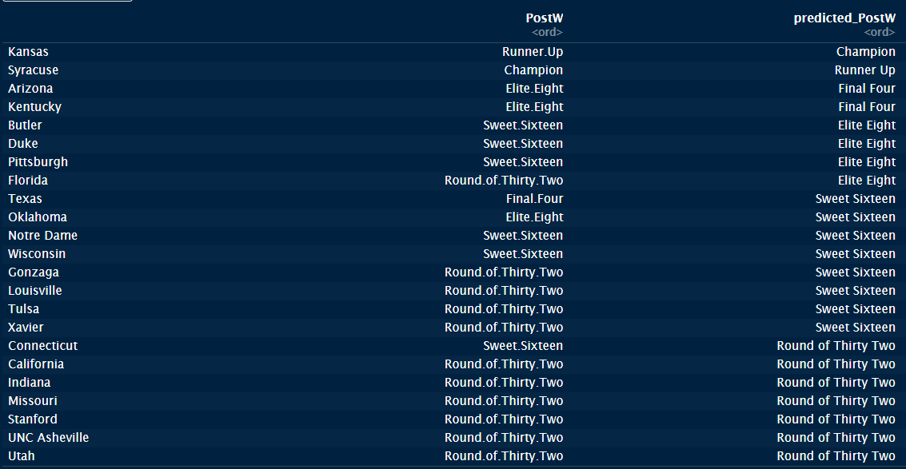
Jackknife Model Application
Final Predictions (2003 Season)
Notes:
- I predicted Kansas to beat Syracuse in the title game, but Syracuse ended up winning (not a huge discrepancy)
Two biggest incorrect predictions:
- Florida was eliminated in the 2nd round but I predicted them to make it to the Elite 8
- Texas made the Final 4, but I predicted them to lose in the Sweet 16

Slide 16
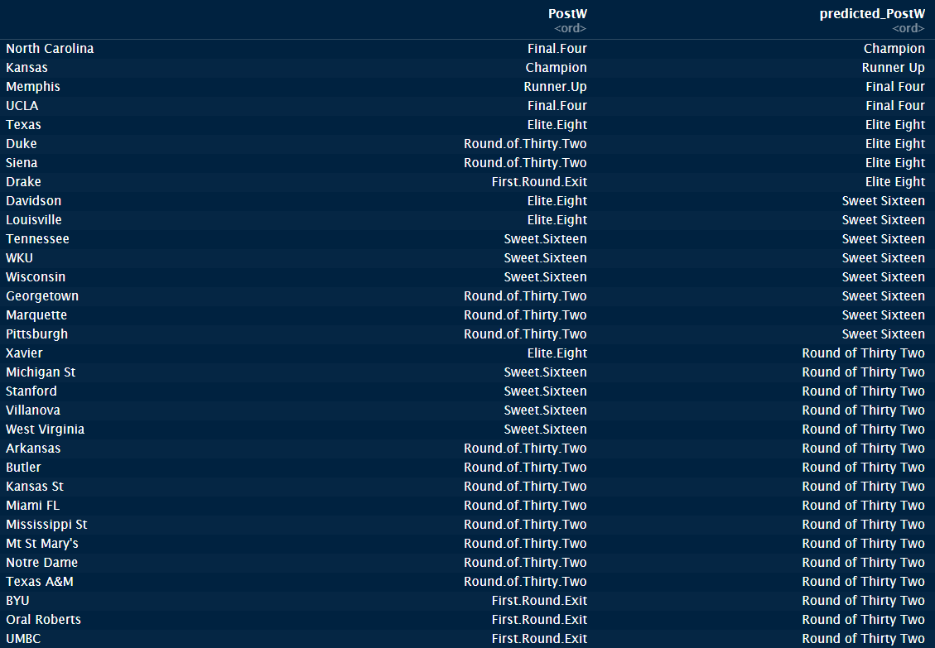
Jackknife Model Application
Final Predictions (2008 Season)
Notes:
Three biggest incorrect predictions:
- Duke and Siena were eliminated in the Round of 32, but I predicted them to make the Elite 8
- Xavier made the Elite 8, but I predicted them to lose in the Round of 32

Slide 17
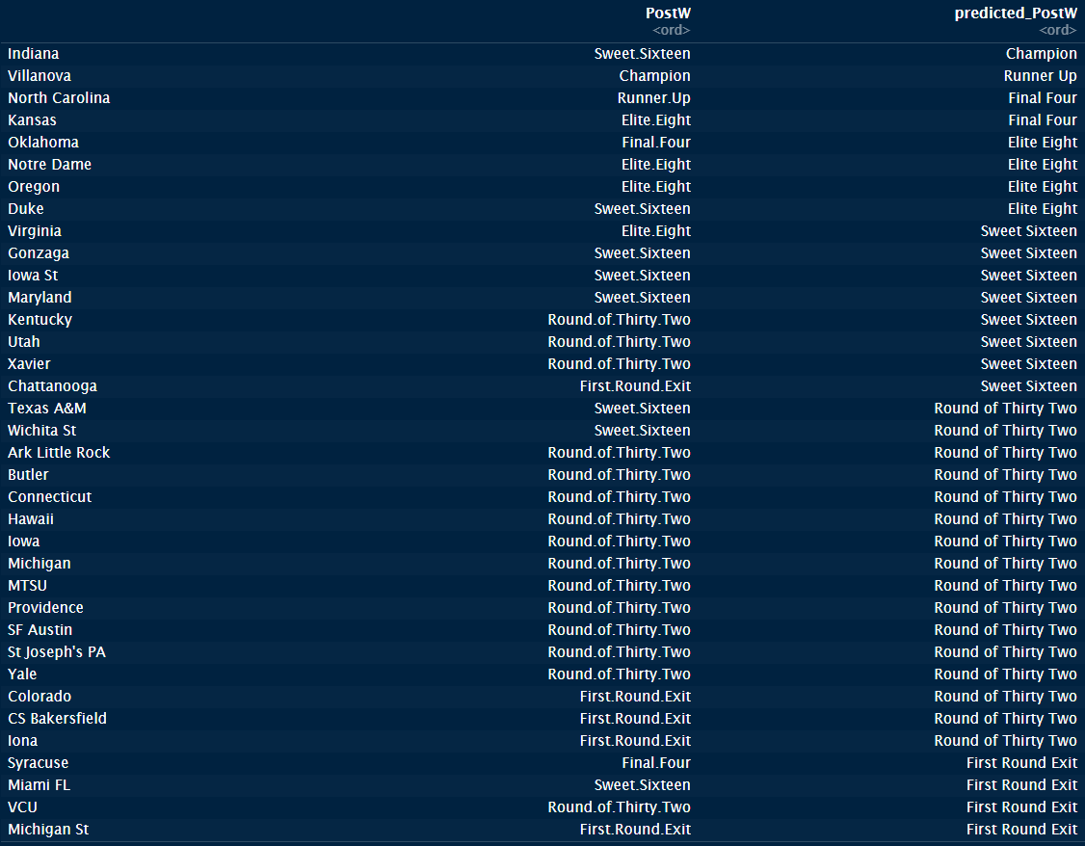
Jackknife Model Application
Final Predictions (2016 Season)
Notes:
Three biggest incorrect predictions:
- Indiana was eliminated in the Sweet 16, but I predicted them to win the entire tournament
- Chattanooga was eliminated in the first round, but I predicted them to make the Sweet 16
- Syracuse made the Final 4, but I predicted them to lose in the first round
With more time, I would like to actually put these predictions into a bracket and score it like any march madness bracket would be scored

Slide 18
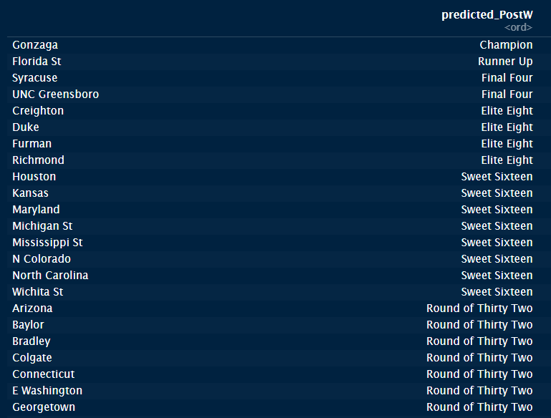
Jackknife Model Application
Final Predictions (2020 Season)
Notes:
The model predicts that if the 2020 March Madness Tournament were to have run uninterrupted, Gonzaga would have been the Champion

Slide 19
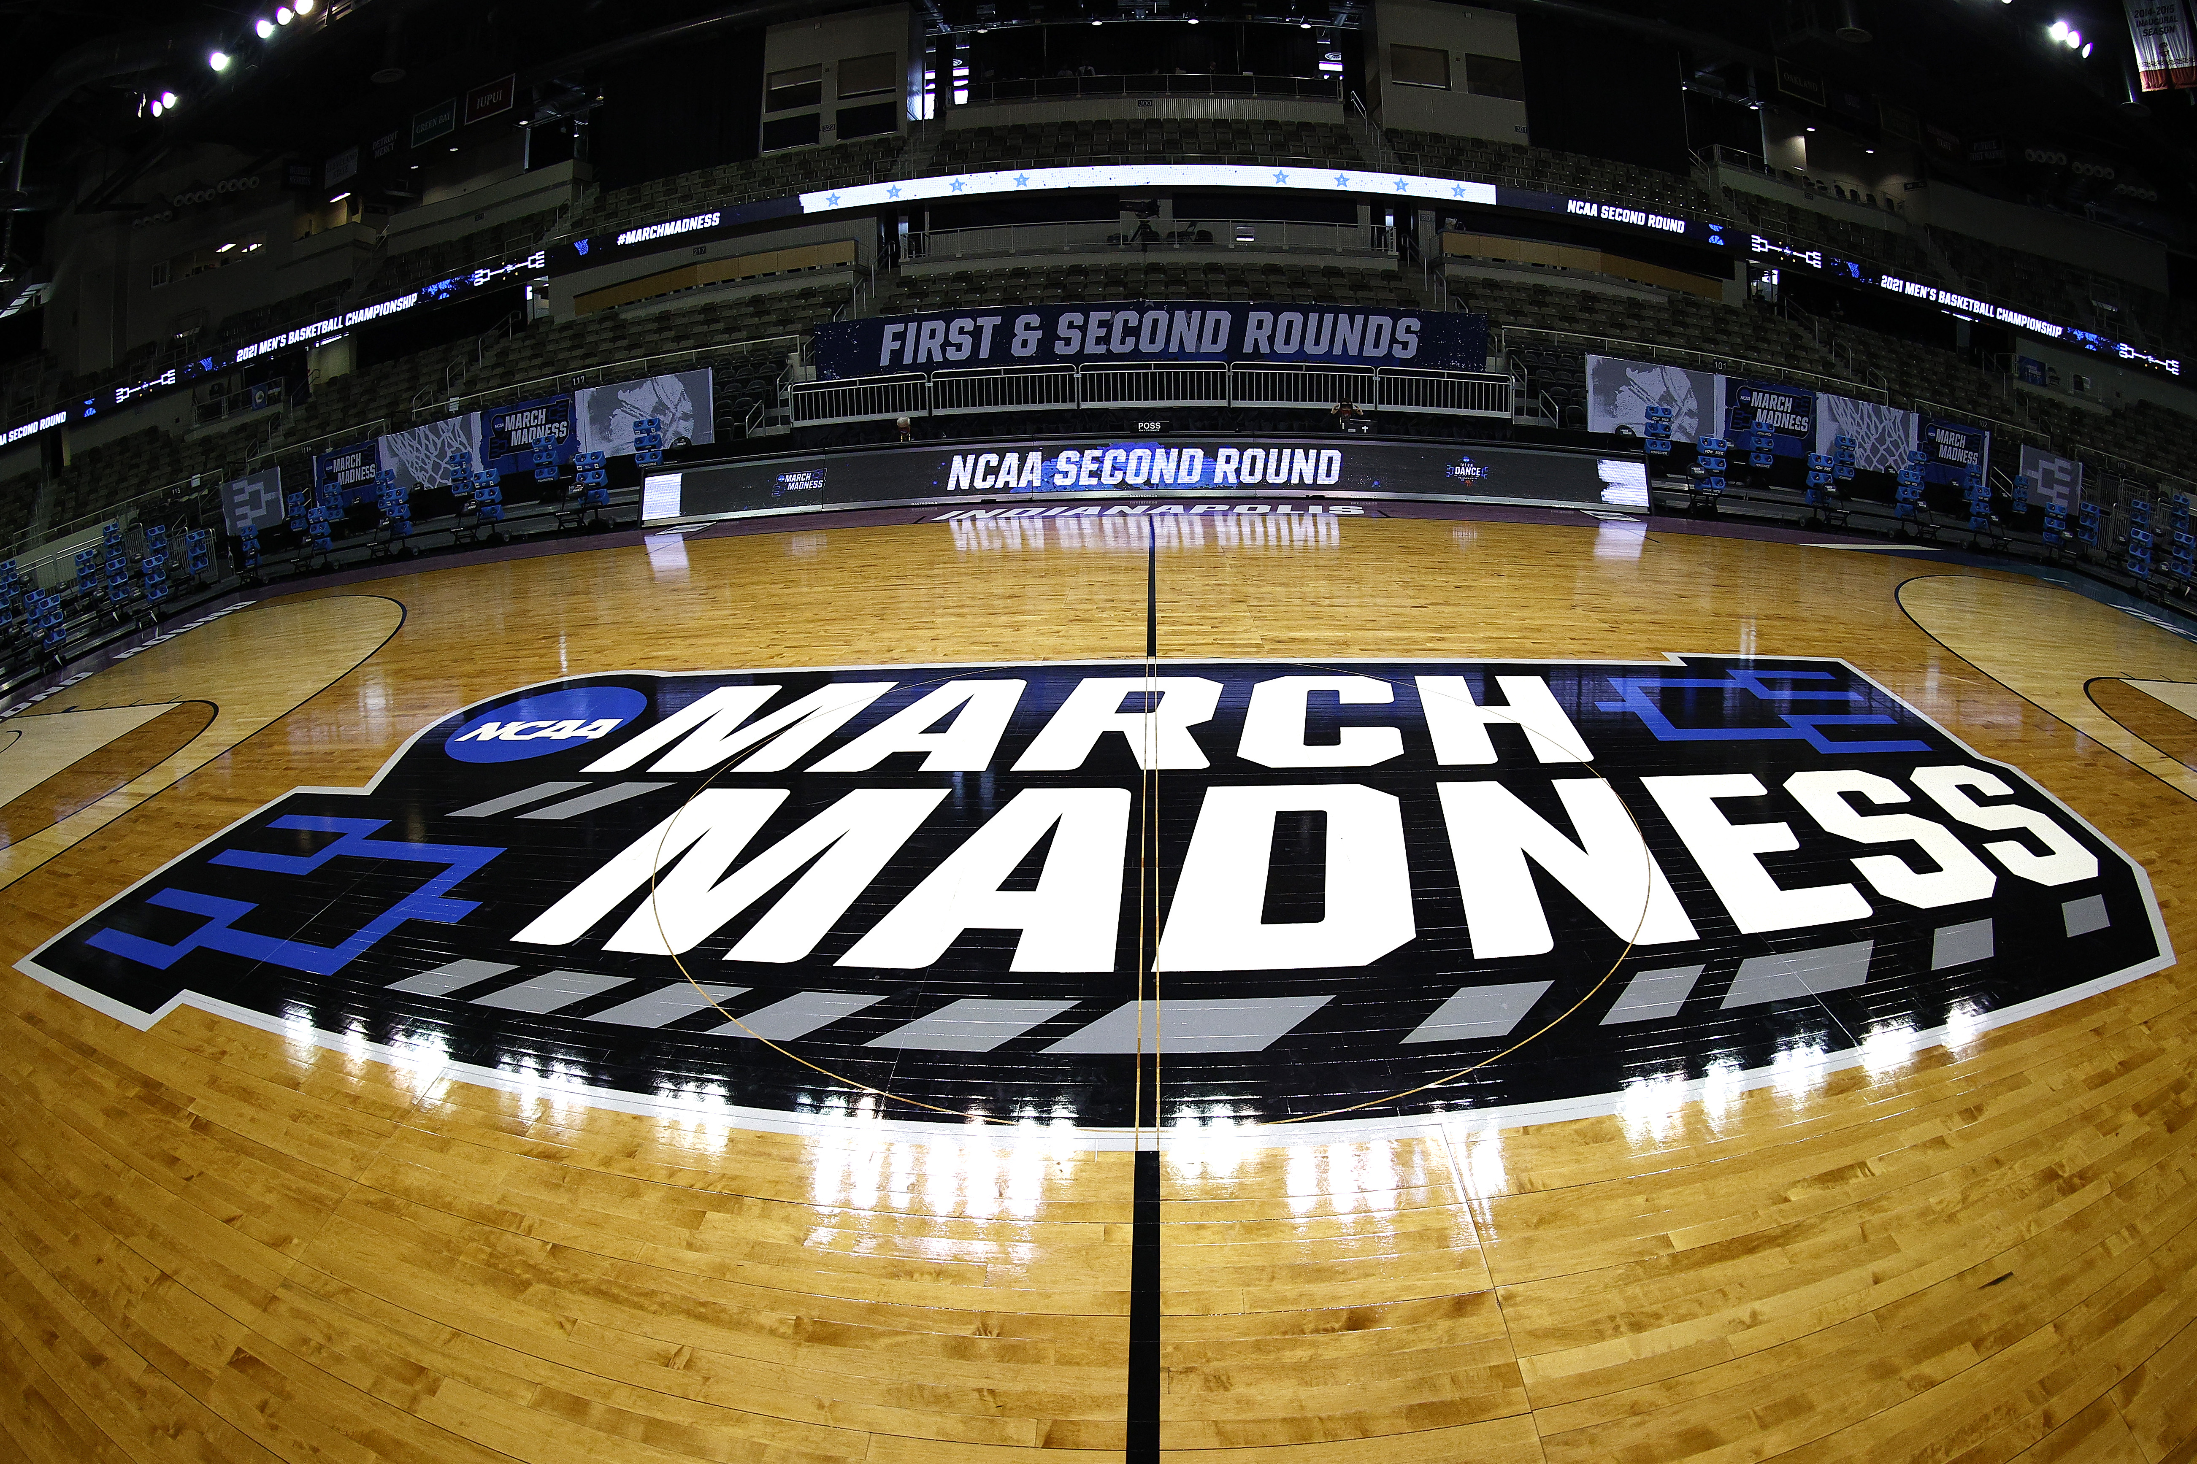
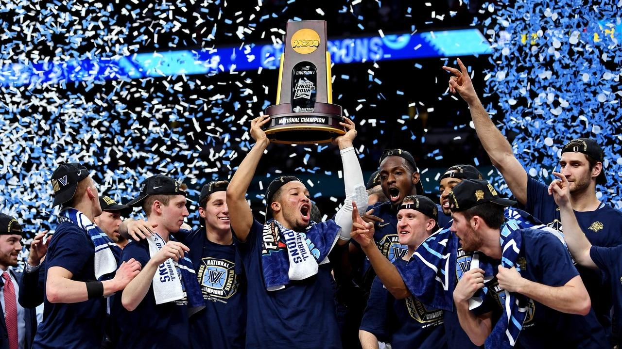
Future Considerations
Multiclass ROC Index
Run model on 2019-2020 season to find out what teams would have the best chance to win if the tournament was played
Apply to 2024 March Madness Tournament once this year’s regular season finishes
Notes:
There is a more robust way of comparing multi class models using Area Under ROC Curve called Multiclass ROC Index, where you can compare micro and macro average ROC curves, which takes into account all of AUC’s from each value of the target variable
Want to also add in conference data, SOS, SRS

